Slide 1

Session 16: Advocacy Campaigning
and Working with the Media
What is advocacy?
What is campaigning?
What are your successes?
What are your challenges?

Slide 2
Who does advocacy?
Approaches to advocacy
The advocacy cycle

Slide 3
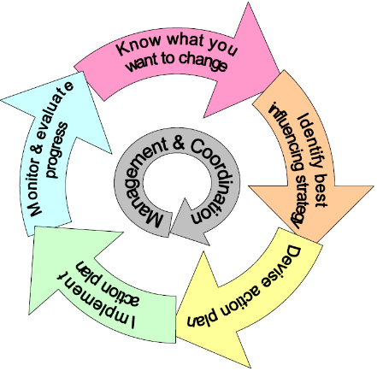
The Advocacy Cycle

Slide 4
Session 16: Advocacy Campaigning and Working with the Media
The basis of successful advocacy is the truth
The key to credibility is accurate information
Understatement often succeeds best
Message must be credible to other side
The successful advocate seeks to educate

Slide 5
Learning from SNUPA’s Experience
Lillian with
baby Carolyn
Susan

Slide 6
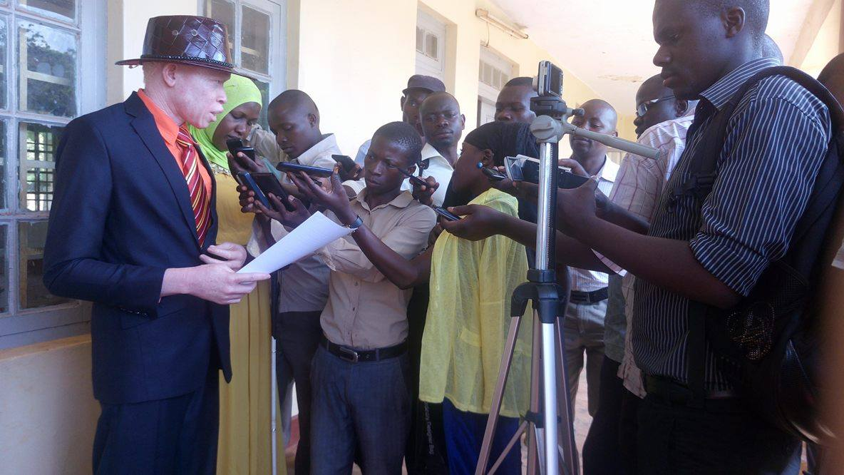

Slide 7
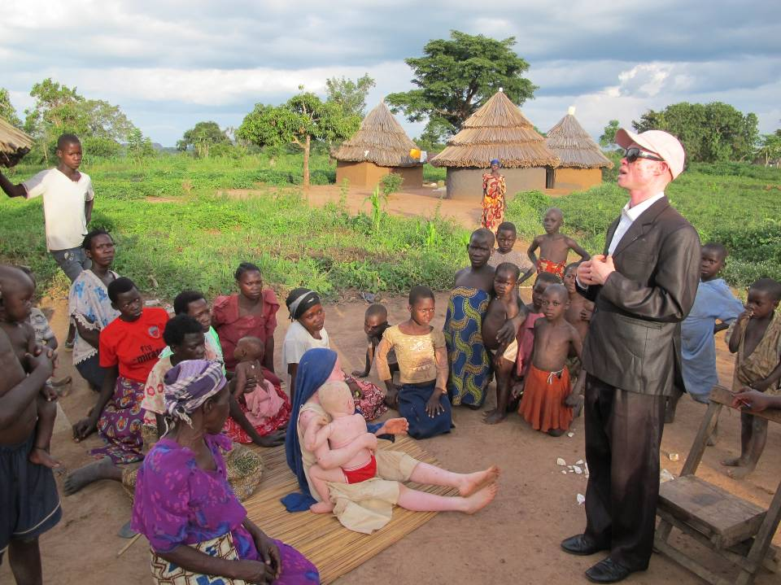
Raising Awareness

Slide 8
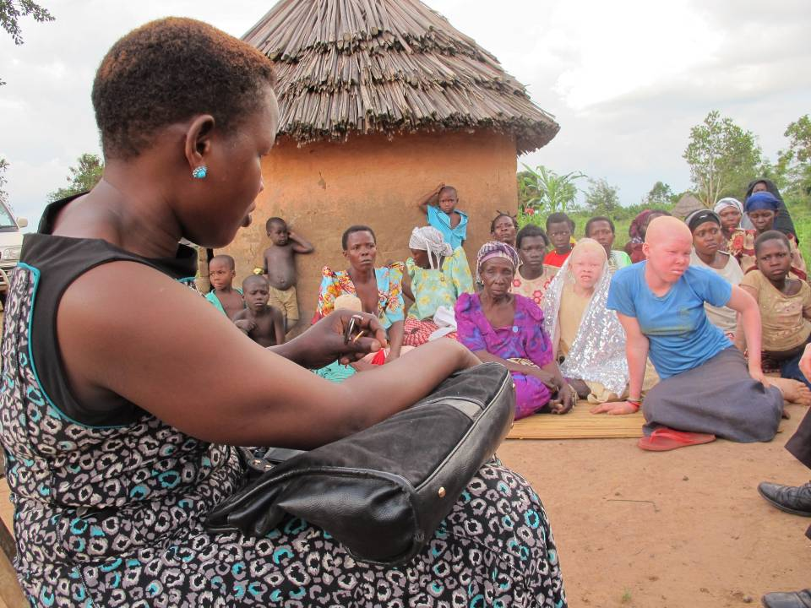
Villages and rural areas

Slide 9
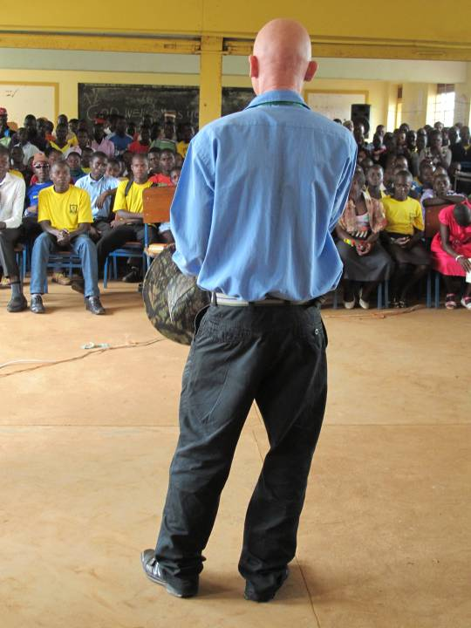
Schools

Slide 10
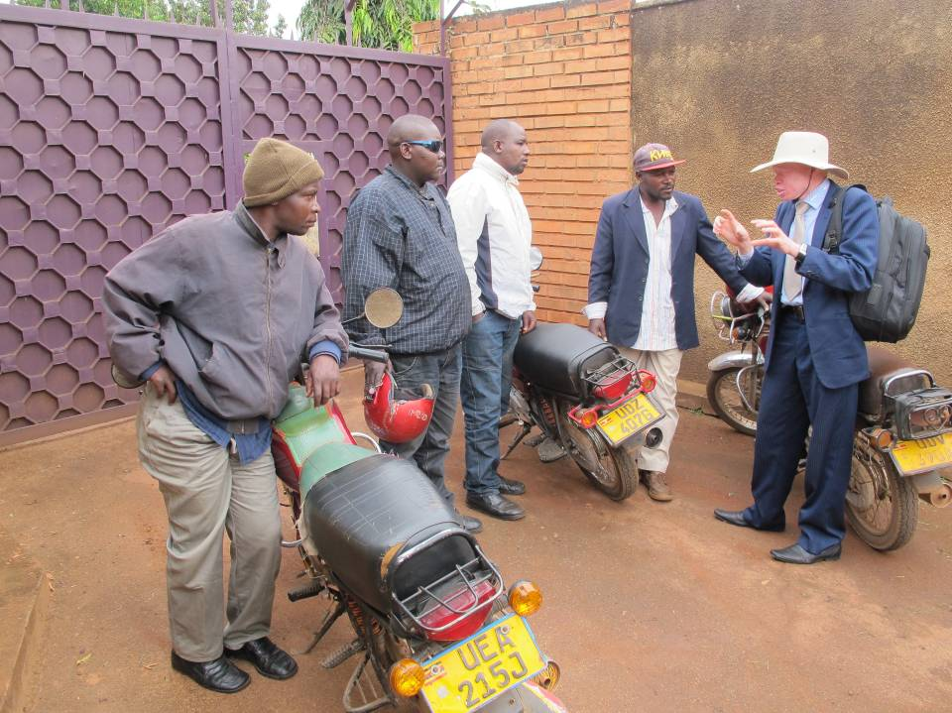
Cities

Slide 11
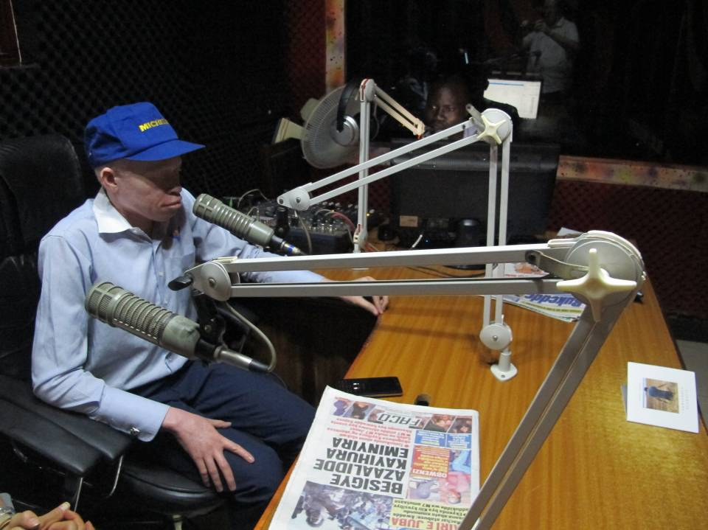
Radio

Slide 12
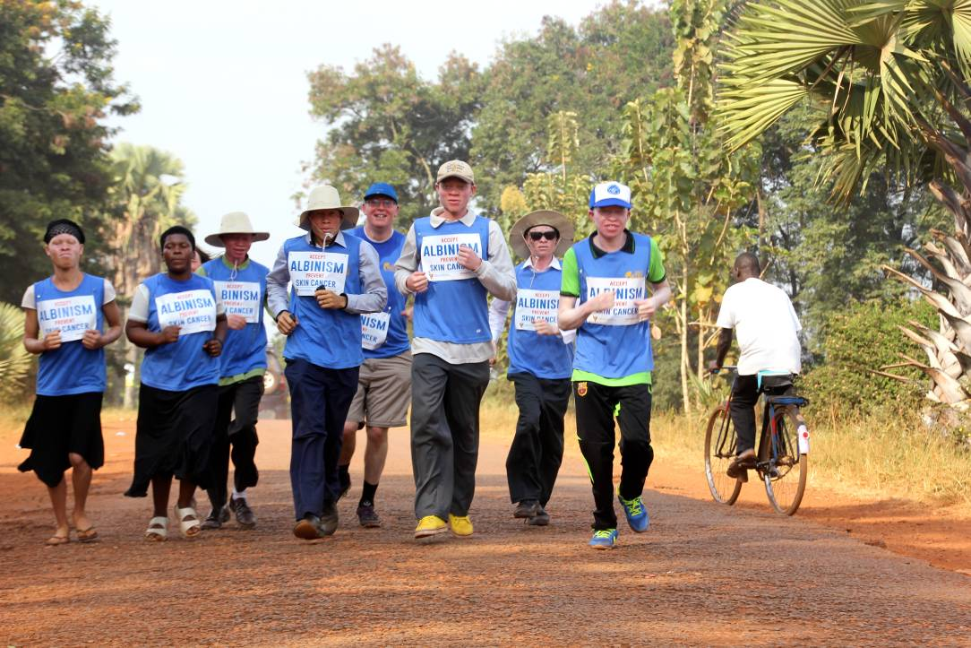
Events

Slide 13
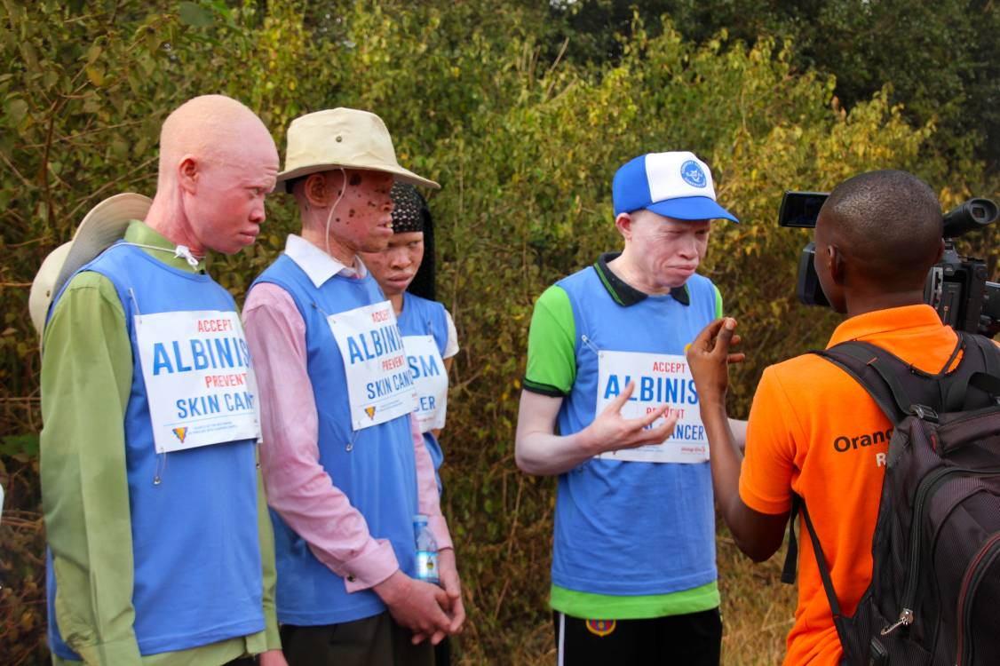
TV

Slide 14
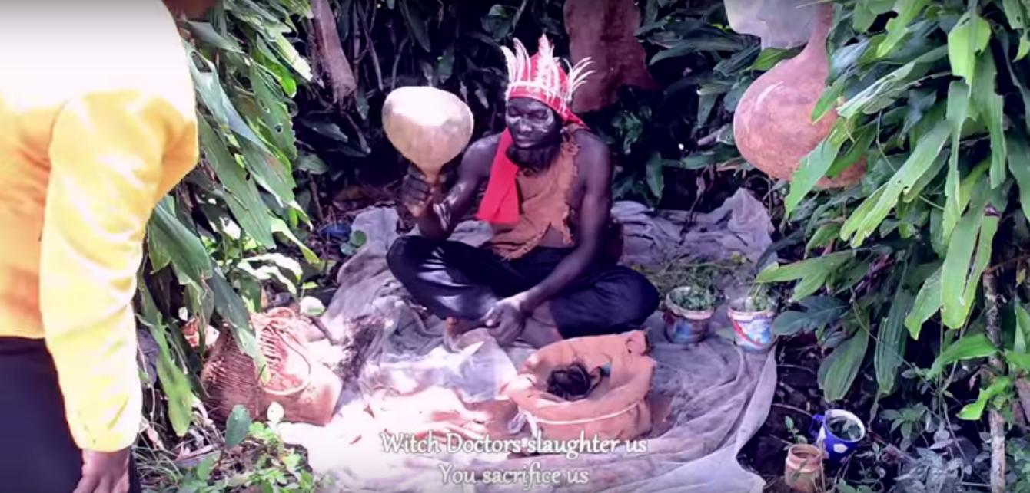
Music

Slide 15
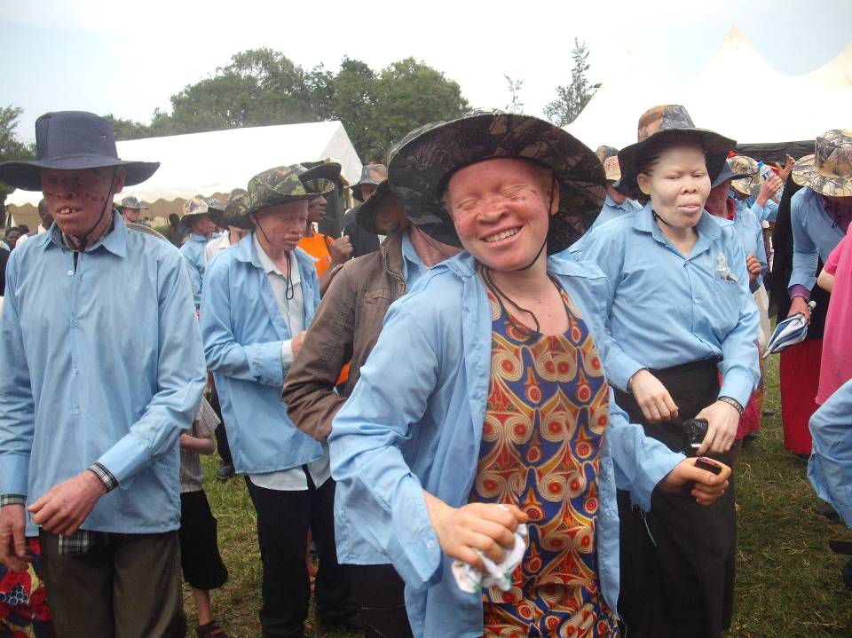
IAAD

Slide 16
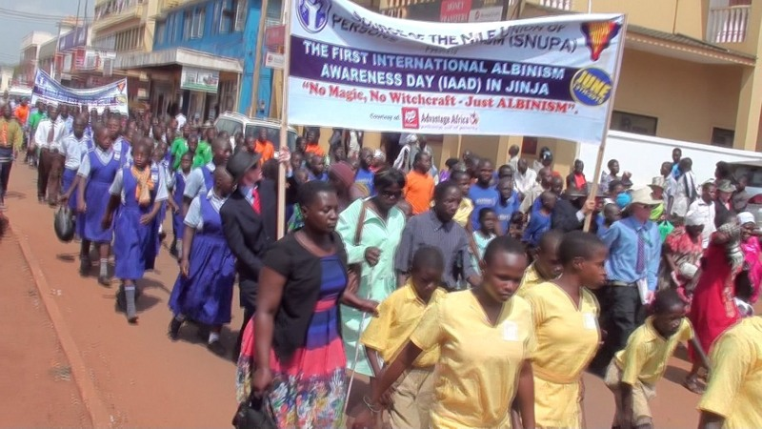

Slide 17
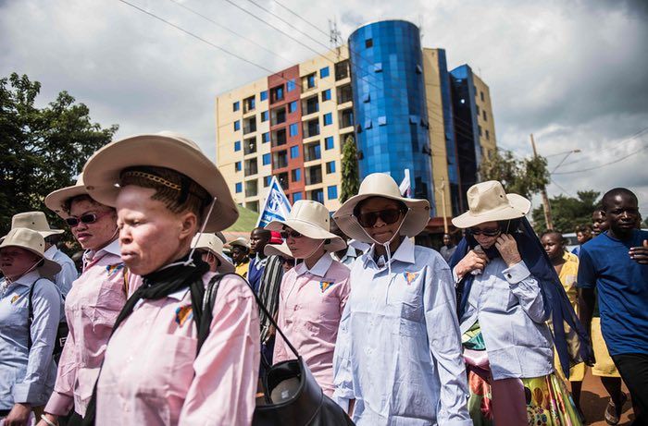

Slide 18
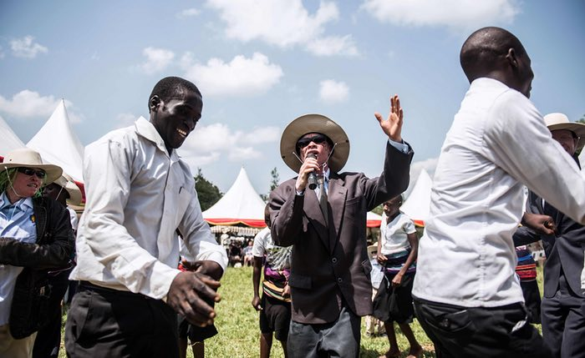

Slide 19
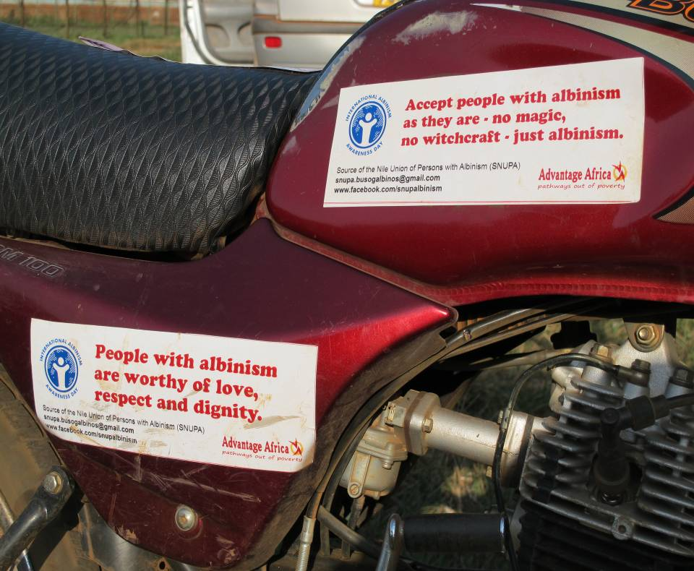
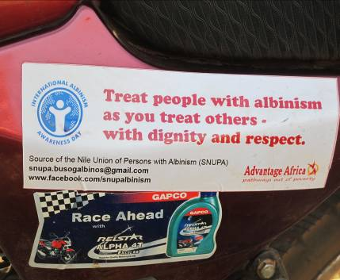
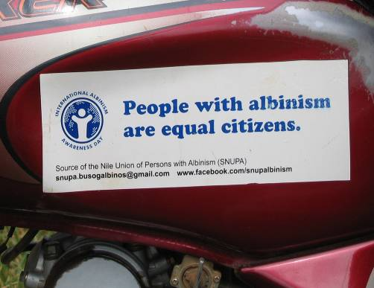
Getting the message out

Slide 20
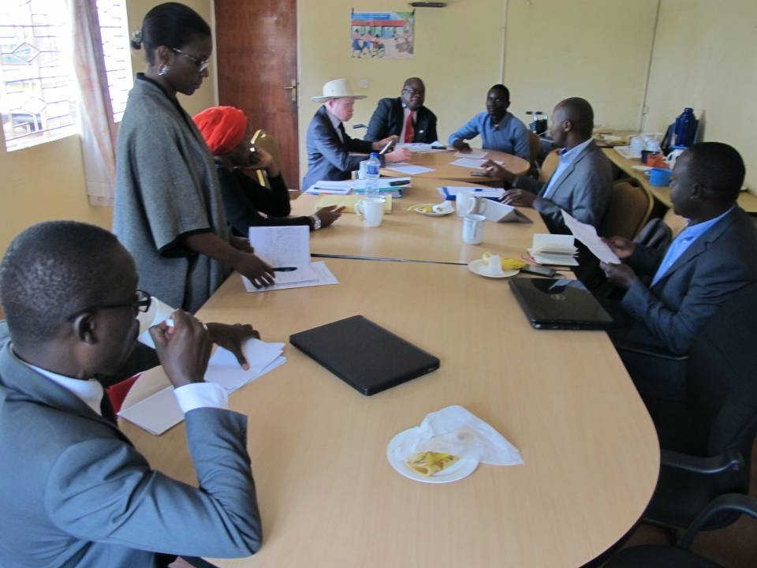
In boardrooms

Slide 21
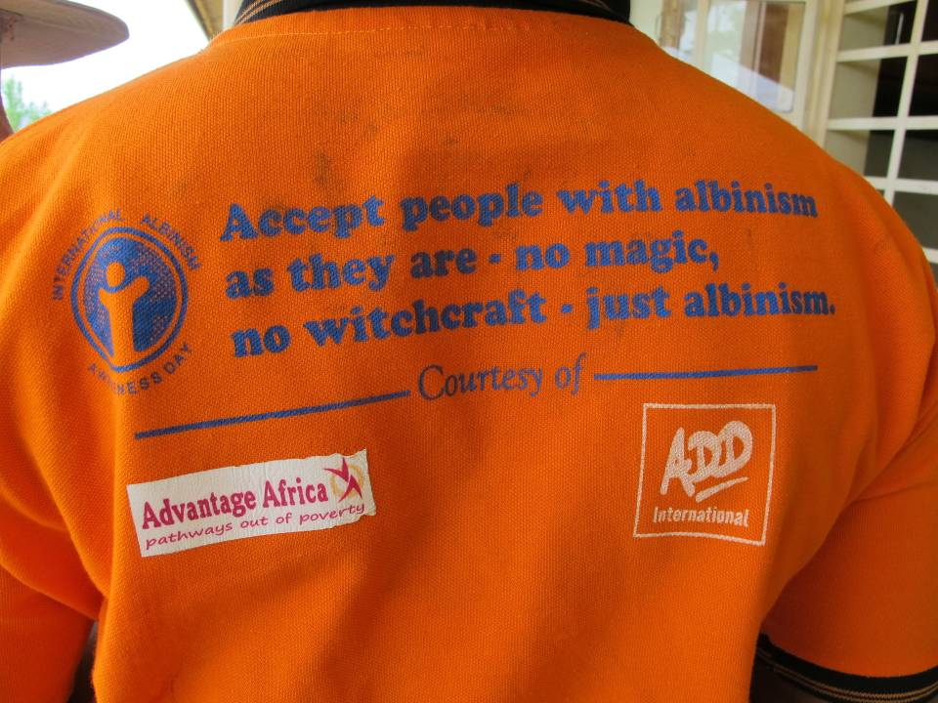
Whatever it takes

Slide 22
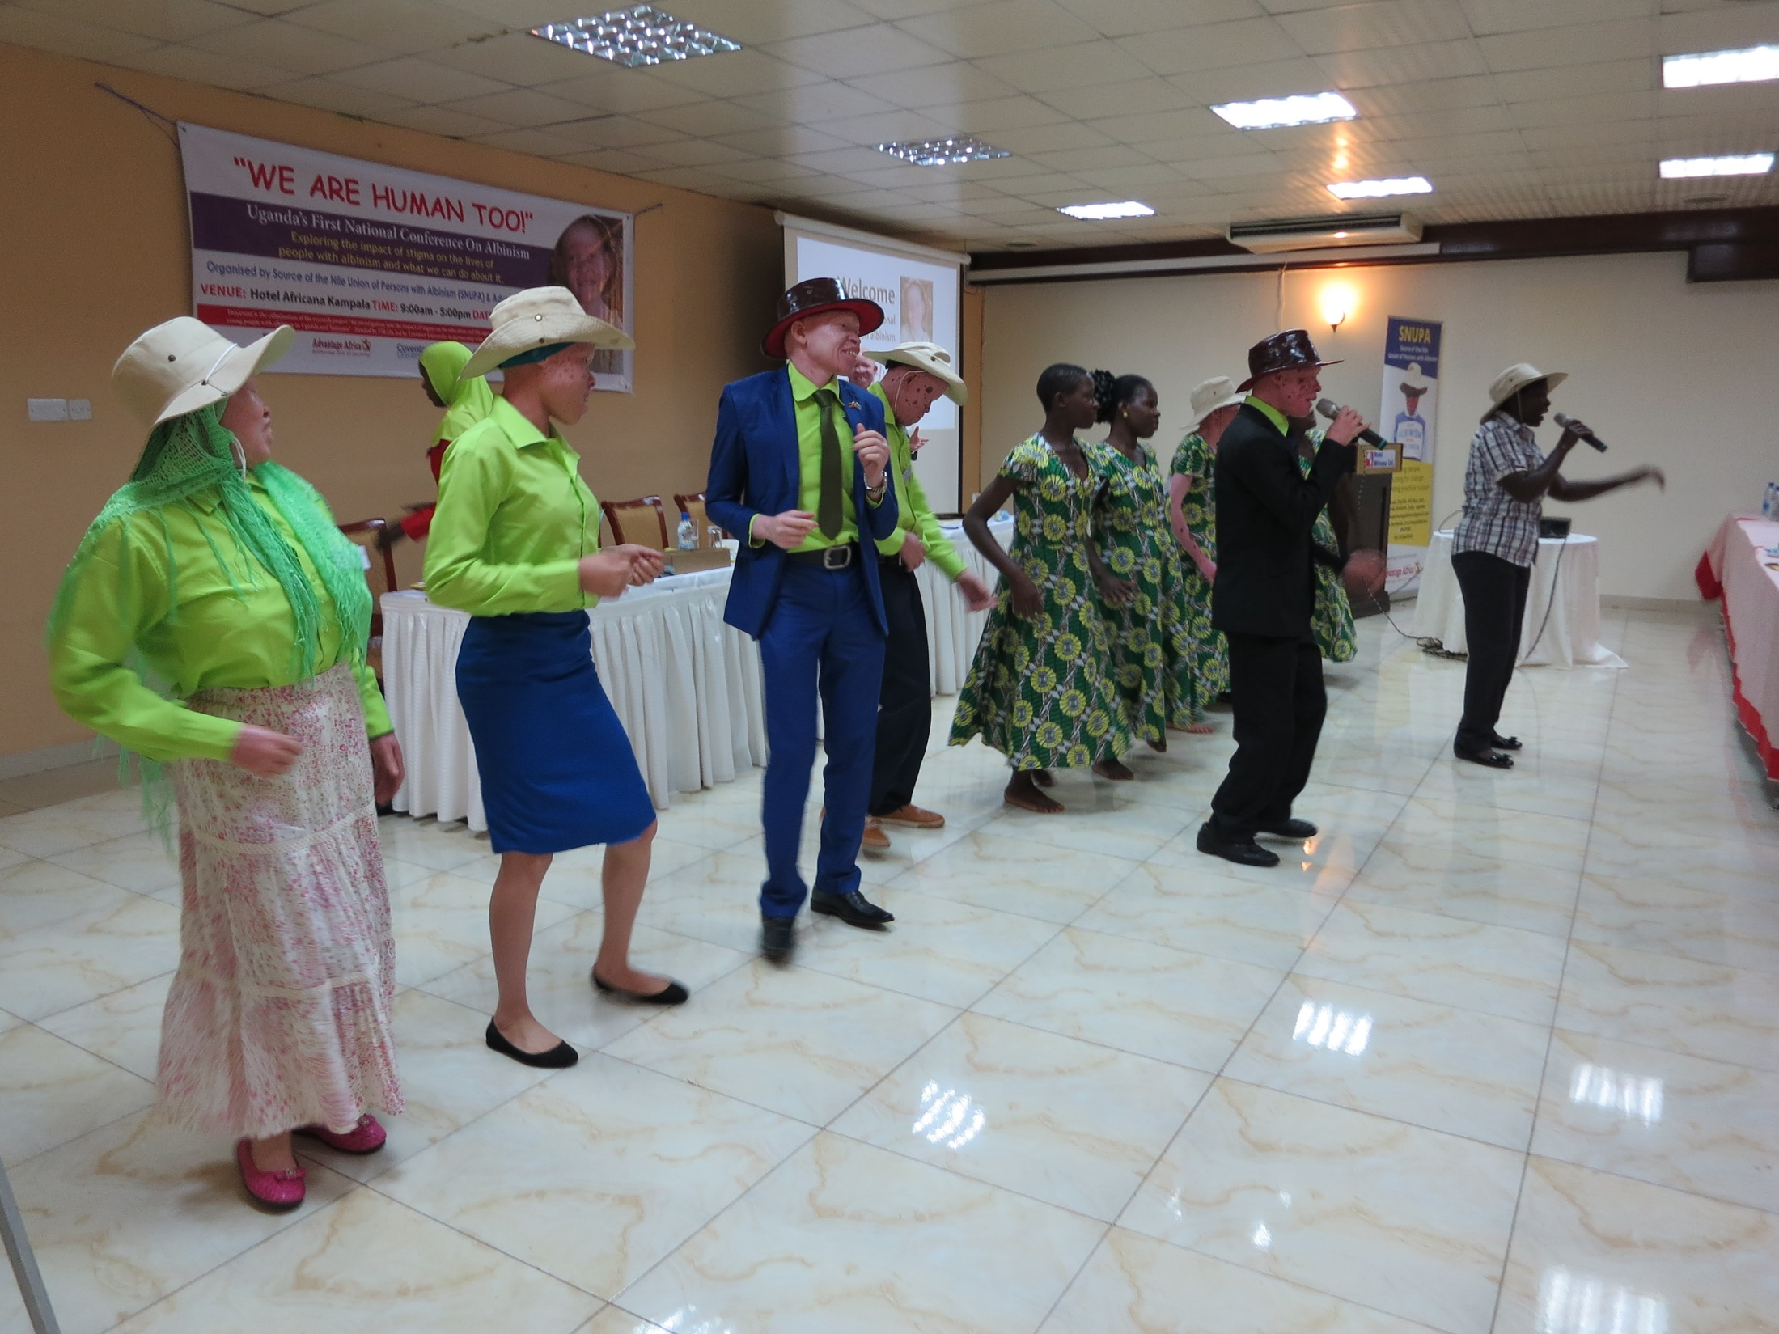
National conference

Slide 23
Working with the Media
Lillian with
baby Carolyn
Susan

Slide 24
Action Points
Lillian with
baby Carolyn
Susan

