Slide 1
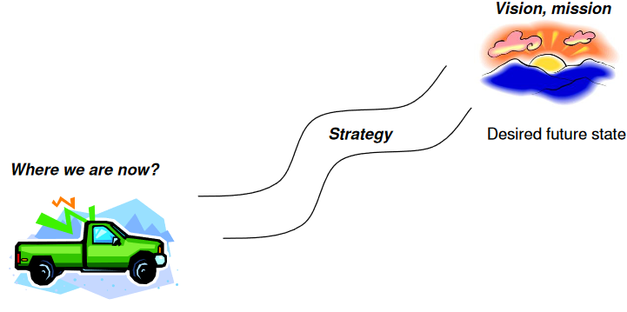
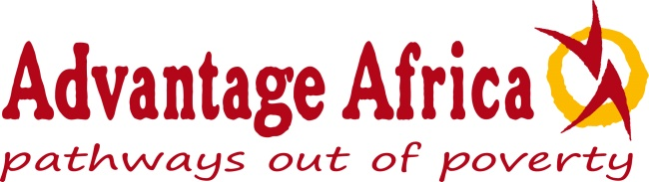
Session 3: Advantage Africa’s Strategic Plan
Lillian with
baby Carolyn
Susan

Slide 2
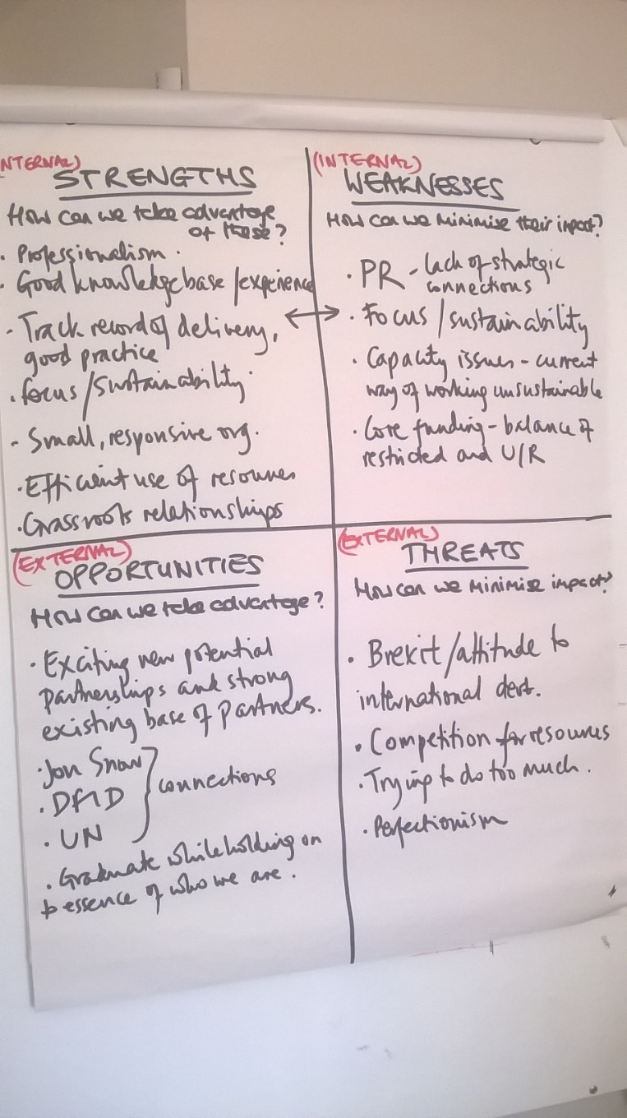
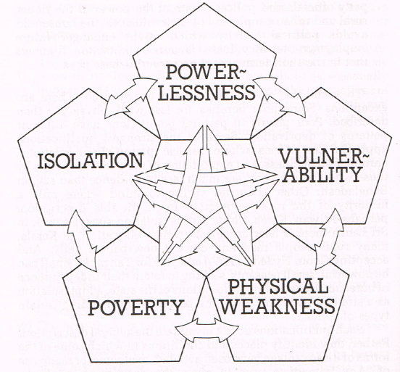
SWOT analysis
Deprivation Trap

Slide 3
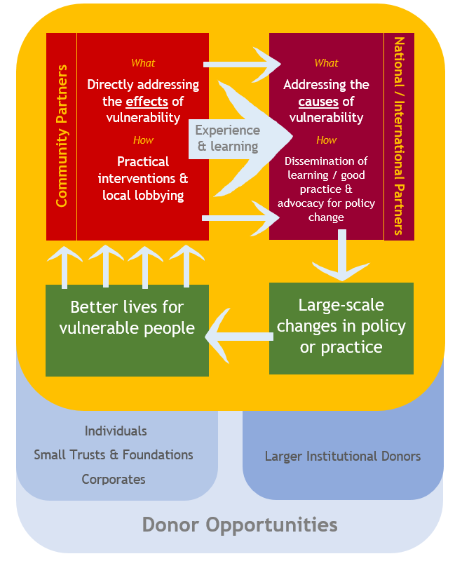
Focus of organisation
Lillian with
baby Carolyn
Balanced approach
75% at community level
25% advocacy / dissemination
Bashir

Slide 4
We’ve also discussed …
Lillian with
baby Carolyn
Where we are working
In at least two countries
Open to a merger
Who to work with
Existing partnerships will be reviewed
Which partners fit with twin approach? Expand/ reduce?
New partners - require intensive support
Some existing partners - quite intensive support
Exiting partners – less intensive support eg fundraising
Bashir

Slide 5
Lillian with
baby Carolyn
What type of activities
Focus on beneficiary type not sector
Remain holistic, so might include water, livelihoods, health
.. among disabled people, people with albinism etc
Beneficiaries
Disabled people
People affected by HIV?
Women and girls? Street children?
Leaving no one behind
Bashir

Slide 6
Lillian with
baby Carolyn
Capacity and funding. What we aim to achieve for:
Community development
Advocacy and dissemination
Improving our health and sustainability
eg fundraising – fewer, bigger grants?
IT and finance systems, staff roles etc
Bashir

Slide 7
Now its your turn to contribute
Lillian with
baby Carolyn
What do you think?
How could your organisation help us achieve impact:
Community development
Advocacy and dissemination
What are your priorities for our partnership?
How could we help your work become sustainable?
What do we do well?
What could we do better or more of?
What should we stop doing?
Any other comments?
Bashir

Slide 8
Action Points
Lillian with
baby Carolyn
Susan

