Slide 1

Session 6 and 7:
Fundraising and Sustainability
Lillian with
baby Carolyn
Susan
What have you learned
  From your bad experiences of fundraising?
  From your good experiences of fundraising?

Slide 2
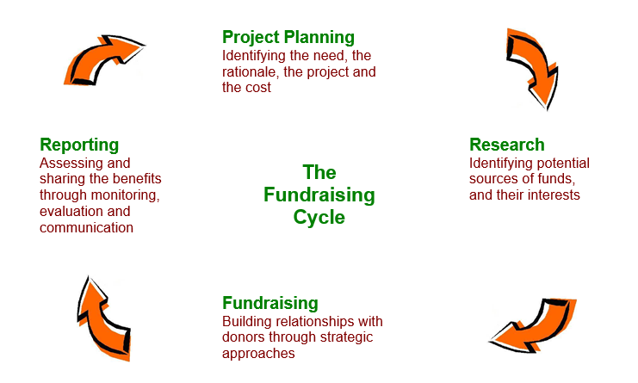
The Fundraising Cycle
Lillian with
baby Carolyn
Susan

Slide 3
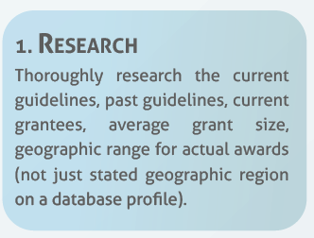
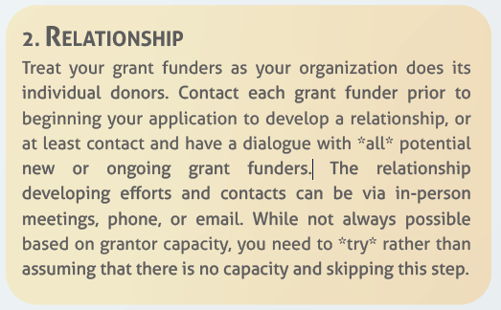
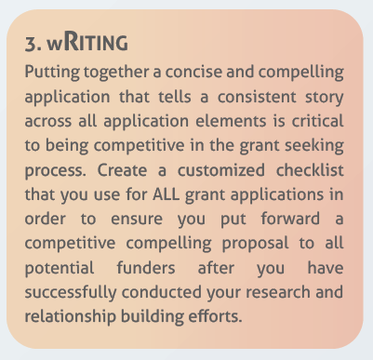
The three Rs of Grant Seeking

Slide 4
Fundraising Roles and Research
Lillian with
baby Carolyn
Who does what in your organisation?
How do you research donors?
What key information do you need?
  Policies and priorities
  Grant: sizes, proportions and duration
  Application procedure
  Deadlines
Bashir

Slide 5
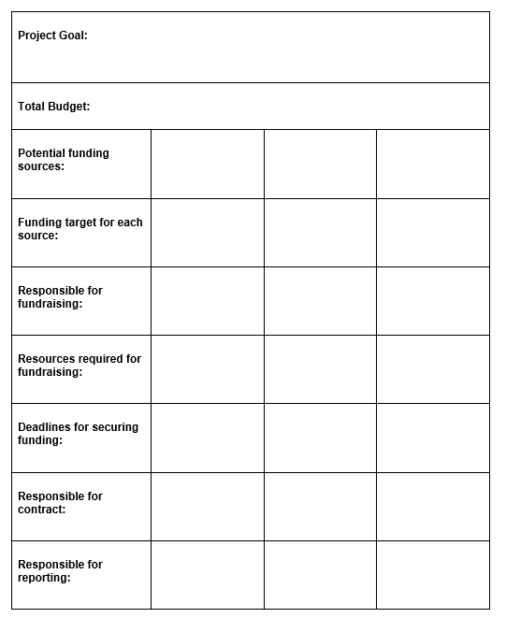
Fundraising Strategy
Lillian with
baby Carolyn
What is a fundraising strategy?
Why do we need one?
What should it contain?
Bashir

Slide 6
What Makes a Good Proposal?
(Characteristics)
Lillian with
baby Carolyn
A good, well-planned project with clear and realistic objectives
Meeting the donors criteria and guidelines
A clear presentation and layout
Strong illustrations, if appropriate
A clear and consistent writing style
Timely arrival
Bashir

Slide 7
Project title, contents and summary
Background and need
Your organisation’s relevant experience
Objectives
Activities
Beneficiaries
Partners
Sustainability
Wider impact through dissemination
Monitoring and evaluation
Assumptions and risks
Timetable
Staff and other resource inputs
Budget
If required, logframe and appendices
Lillian with
baby Carolyn
What Makes a
Good Proposal?
(Content)
Bashir

Slide 8
Proposal Critique
Lillian with
baby Carolyn
Are the objectives clear and achieveable?
Will the project reach the beneficiaries?
Is the project sustainable?
Does the project offer good value for money?
Look at the proposal though the donor’s eyes
Bashir

Slide 9
Action Points
Lillian with
baby Carolyn
Susan

